Slide 1
Assembly Language
Simulator

Slide 2
Example 1 - Displaying
In memory address 20 enter the number 25
Now, starting at address zero enter the following:
520 → Load accumulator with the value at memory address 20
902 → Output to the screen
000 → End the program

Slide 3
Example 2 – Adding two numbers
In memory address 20 enter the number 14
In memory address 21 enter the number 26
Now, starting at address zero enter the following:
520 → Load accumulator with the value at memory address 20
121 → Add to the accumulator the value at memory address 21
322 → Store the value of the accumulator at memory address 22
000 → End the program
Can you display it to the screen as well?

Slide 4
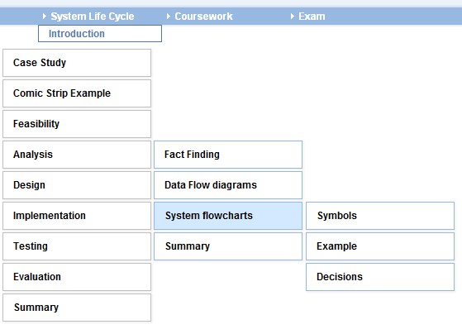
Flow charts
Y:\Computing & IT\2012-2013\ICT Interactive
System Life Cycle
Headphones needed

Slide 5
Flowchart symbols
Start/End
Process
Input / Output
Decision
File store

Slide 6
Sequence
Selection
Iteration
Start
count ← 0
x = 0?
NO
x ← x + 1
Loop
YES
x ← y + 6
x ← x + 1
GET age
YES
count=50?
PRINT age
NO
End
count ← count+ 1

